Slide 1
OLIST STORE ANALYSIS
Presented By
Praveen
Rajani
Swarup
Ganesh

Slide 2

INTRODUCTION
Olist Store is a leading Brazilian e-commerce platform that connects small and medium-sized businesses with customers. It enables merchants to list their products and services across various marketplaces while efficiently managing their sales operations.
This analysis aims to:
1.Explore the company's product volume, sales, and customer satisfaction rating for products.
2. Analyze delivery performance.
3. Investigate product ratings and discover product categories that are prone to customer dissatisfaction.
4. To analyze the preferred mode of payment used by customers.
By conducting this analysis, we aim to uncover valuable insights that can:
1. Support data-driven decision-making
2. Enhance operational efficiency & customer satisfaction
3. Optimize marketing strategies, inventory management & seller onboarding
These findings could serve as a strategic guide to improving Olist Store's overall e-commerce ecosystem.

Slide 3
DATA OVERVIEW
The given dataset consists of 100k e-commerce orders from 2016 to 2018, structured across 9 CSV files. These files allow us to analyze various aspects of the business, including:
1. Order Status : Track the journey of orders from placement to fulfillment
2. Pricing & Payments : Understand pricing strategies and preferred payment methods
3. Freight & Delivery : Analyze shipping costs and delivery times
4. Customer Insights : Explore customer locations, behaviors, and feedback
5. Seller Performance : Assess marketplace dynamics and seller contributions
By leveraging this dataset, we can extract valuable insights to enhance decision-making, improve operational efficiency, and optimize customer experience.

Slide 4
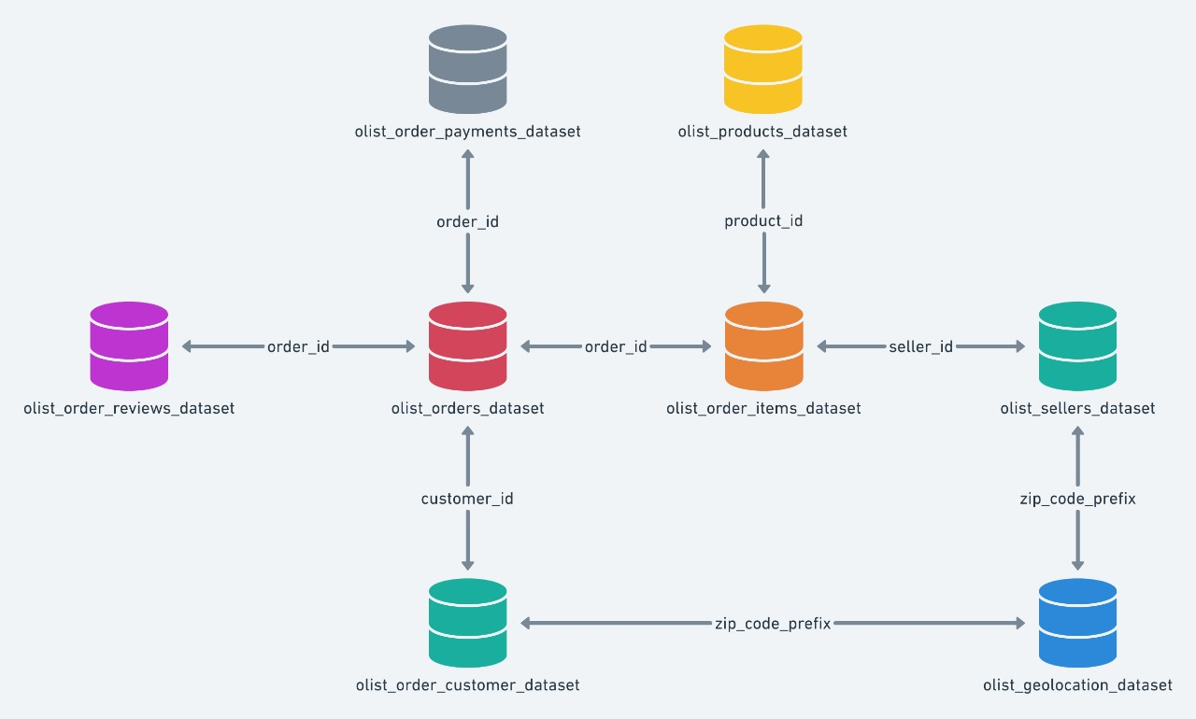

Slide 5

OBJECTIVES
KPIS:
1. Weekday Vs Weekend Payment
2. Orders By Review Score 5 And Payment Type as Credit card
3. Average order delivery days for pet shop
4. Average Payment value and average price for Sao Paulo
5. Relationship between shipping days vs review score

Slide 6
PROCESS
1. Data Import:
Imported data from 9 CSV files, including:
Customers dataset, Order Items dataset, Payment dataset, Reviews dataset, Orders dataset, Products dataset, Seller dataset, Geolocation dataset, Product Category dataset.
2. Data Cleaning & Transformation:
Extracted, renamed, and reordered columns for consistency.
Dropped unnecessary columns.
Filtered and removed null and blank rows to ensure data accuracy.
3. Data Integration:
Merged all 9 datasets to create a unified dataset with relevant information.
4. Data Deduplication:
Identified and removed duplicate entries to maintain data integrity.

Slide 7
ANALYSIS

Slide 8
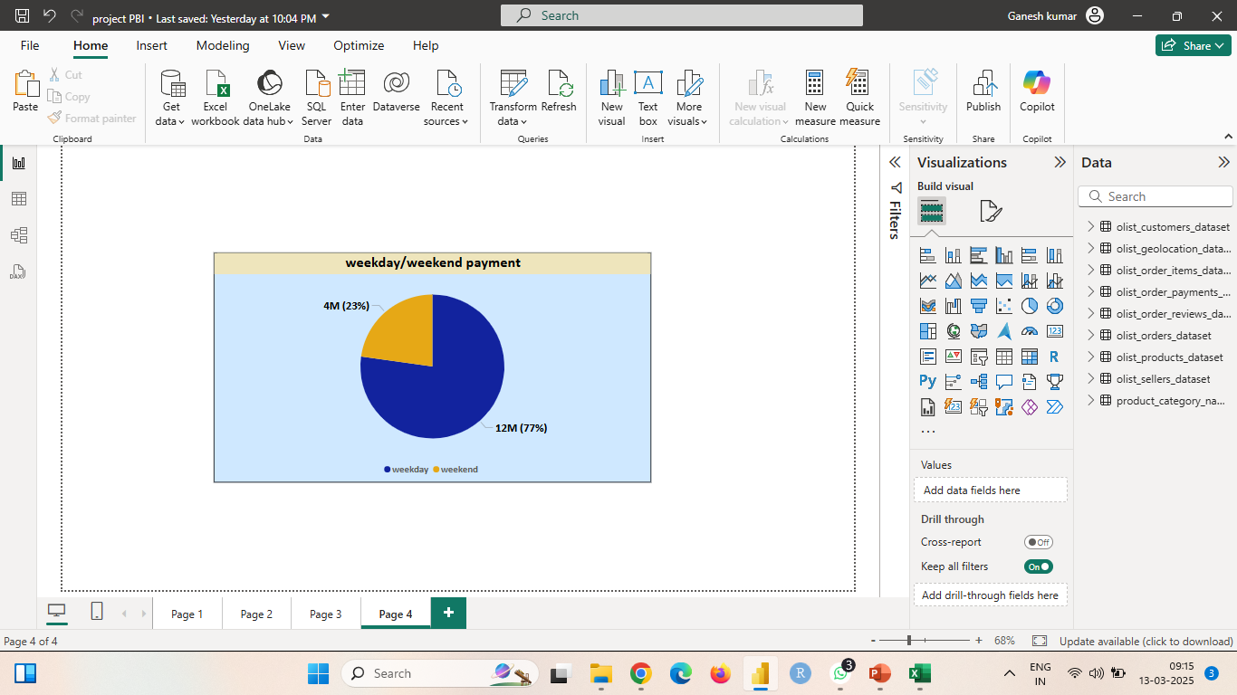
1. Weekday Vs Weekend Payment
We analyzed the payment data based on transactions occurring on weekdays vs weekends.
Key Insights:
a. Higher Transactions on Weekdays – Customers tend to shop more during the workweek.
b. Lower Weekend Sales – Fewer purchases and lower payment value on weekends.
Payment Distribution:
Weekdays: $12.40M (77.44%)
Weekends: $3.61M (22.56%)
Conclusion:
Customers are significantly more active on weekdays than weekends, indicating that marketing and promotional strategies should focus on weekday engagement.

Slide 9
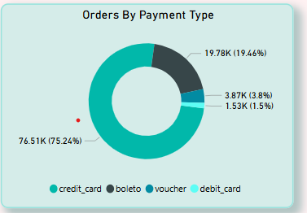
2. Orders By Review Score 5 And Payment Type
This analysis focuses on orders with a review score of 5 and the preferred mode of payment
Key Findings:
a. Credit Card Dominates – The majority of customers prefer using credit cards.
b. Boleto is the Second Choice – A significant portion still opts for boleto (bank slip).
c. Lower Preference for Debit Cards & Vouchers – Limited adoption compared to other payment methods.
Payment Method Breakdown:
Credit Card: 74.62% (45,170 orders)
Boleto: 18.99% (11,495 orders)
Voucher: 4.82% (2,915 orders)
Debit Card: 1.57% (950 orders)
Average Review Score: 4.0
Conclusion:
Customers who give high ratings (5 stars) predominantly use credit cards, indicating a smoother payment experience. Strategies can be developed to enhance adoption of other payment methods.

Slide 10
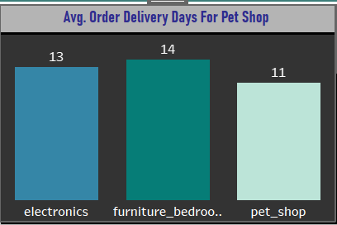
3. Average order delivery days for pet shop
We analyzed the average shipping time for different product categories, focusing on Pet Shop orders.
Shipping Time Breakdown by Category:
Pet Shop: 11 days (average delivery time)
Furniture_Bedroom: 14 days
Electronics: 13 days
Overall Average: 13 days
Conclusion:
The Pet Shop category has the fastest delivery time, taking 11 days on average, which is below the overall average. In comparison, categories like Furniture_Bedroom and Electronics take longer to deliver.

Slide 11
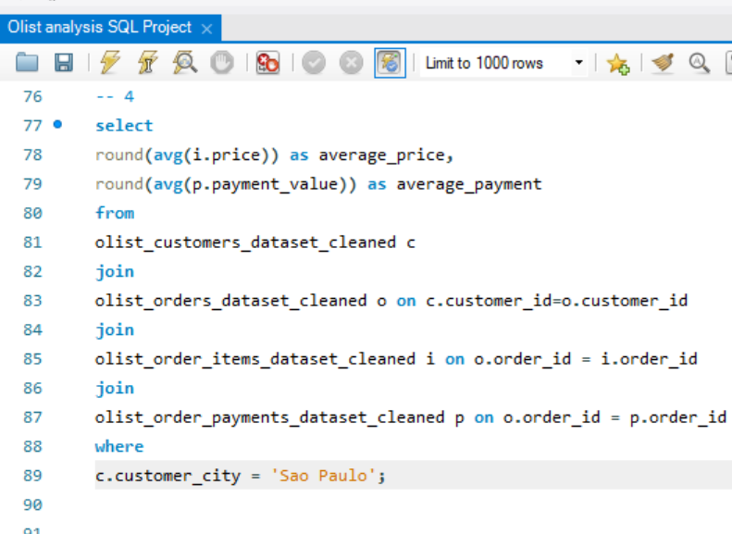
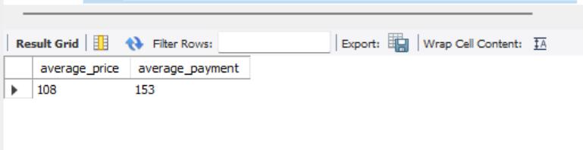
4. Average Payment value and average price for Sao Paulo
This KPI focuses on the analysis of the average payment value and average product price for Sao Paulo City.
Key Metrics:
a. Average Payment Value: 135.04
b. Average Price: 107.53
c. Customer Base in Sao Paulo: 16,337 customers
Conclusion:
Both total price and payment values in Sao Paulo have seen a significant increase over the years, indicating growing customer engagement and higher transaction volumes.

Slide 12
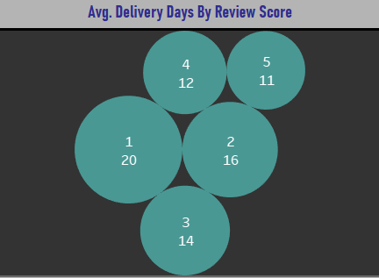
5. Relationship between shipping days vs review score
This KPI analyzes the relationship between shipping days and review scores given by customers.
Key Metrics:
a. Average Estimated Shipping Days: 24 days
b. Average Shipping Days: 13 days
c. Average Review Score: 4
Findings:
Shorter Shipping Days = Higher Review Scores
Highest Review Score (5): Orders shipped within 11 days
Lowest Review Score (1): Orders shipped within 20 days
Conclusion:
Customers tend to rate products lower when shipping times are longer, emphasizing the importance of timely delivery for higher customer satisfaction.

Slide 13
KEY INSIGHTS
Sales Trends:
Weekday sales outperform weekend sales, indicating an opportunity to boost weekend engagement through targeted promotions, discounts, and advertising campaigns.
Payment Preferences:
Credit cards dominate as the preferred payment method (74.62%). To drive adoption of other payment methods, Olist Store can introduce exclusive discounts and offers. The least used mode of payment was Debit card which is 1.57%.
Delivery Impact on Reviews:
The average delivery time is 13 days, while the estimated delivery time is 24 days—a factor influencing customer review scores. Optimizing logistics can enhance customer satisfaction.
Seller Growth: A steady rise in sellers, from 130 in 2016 to 1.7K in 2017 and 2.3K in 2018, highlights a growing marketplace.
Top Revenue City:
Sao Paulo leads in payments, aligning with its status as Brazil’s most populated city, reinforcing its strategic importance for sales and marketing efforts.

Slide 14
Top Revenue Products:
The Health & Beauty category generates the highest revenue at $1.45M, followed by Watches & Gifts and Bed, Bath & Table products. Notably, for Health & Beauty category the highest 5-star reviews, contributing $1.47M in revenue, while 1-star reviews account for $720,698.50, highlighting the significant impact of customer satisfaction on sales. Average order delivery is 12 days, with a total of 8835 orders.
Bottom Revenue City:
Jenipapo de Minas records the lowest revenue, with a payment value of just $22.58 from 1 customer. As one of Brazil's least populated cities, low demand is a key factor in limited sales from this region.
Bottom Revenue Products & Seller Impact:
The Security & Services category is the least contributing, generating only $325 from 2 orders with an average shipping time of 15 days. A key observation is that the bottom 5 product categories have very few sellers, which significantly affects sales:
Security & Services – 2 sellers
Fashion (Children's Clothes) – 4 sellers
CDs, DVDs & Musicals – 1 seller
Home Comfort 2 – 4 sellers
Flowers – 3 sellers (with an exceptionally high average shipping time of 11 days)
Expanding the seller base in these underperforming categories could improve sales and product availability.

Slide 15
CONCLUSION & RECOMMENDATIONS
1. Boosting Weekend Sales:
Olist can implement special promotions and sales on weekends to increase customer engagement.
Since weekday sales outperform weekends, the store should adjust stock levels accordingly to ensure sufficient inventory during peak periods.
2. Diversifying Payment Methods:
To encourage the use of alternative payment methods, Olist can offer exclusive discounts and incentives beyond credit cards.
Regularly monitoring the relationship between credit card orders and review scores will help assess customer satisfaction and identify potential areas for improvement.
3. Expanding Sales Beyond Sao Paulo:
With Sao Paulo leading in customer transactions, Olist should focus on regional marketing campaigns and promotions to drive sales in other key areas.
4. Optimizing Delivery Times:
Reducing delivery time is critical, as long delivery periods negatively impact customer reviews.
Olist should investigate bottlenecks in the shipping process and implement solutions to improve delivery speed and customer satisfaction.
5. Encouraging Seller Growth in Low-Performing Areas & Categories:
To boost sales in less populated regions and underperforming product categories, Olist should provide more incentives and support for sellers in these areas.
Strategies such as lower commission rates, promotional support, and advertising assistance can help attract more sellers and increase product availability.

Slide 16
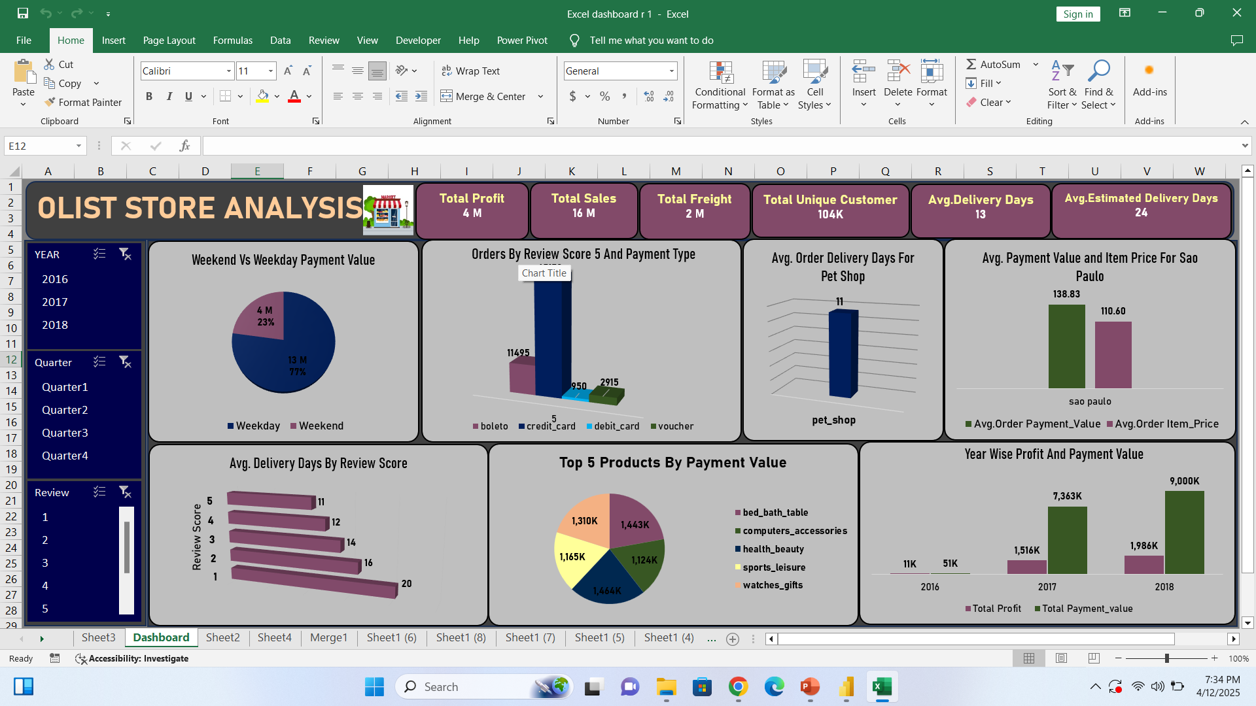

Slide 17
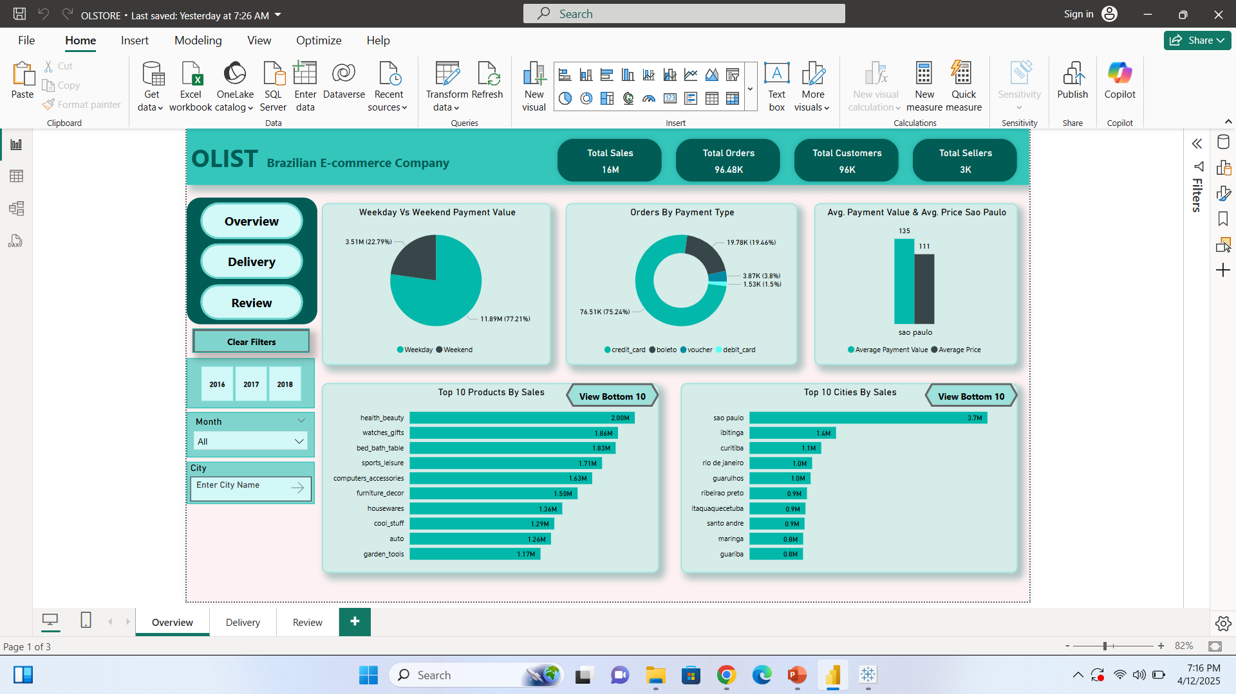

Slide 18
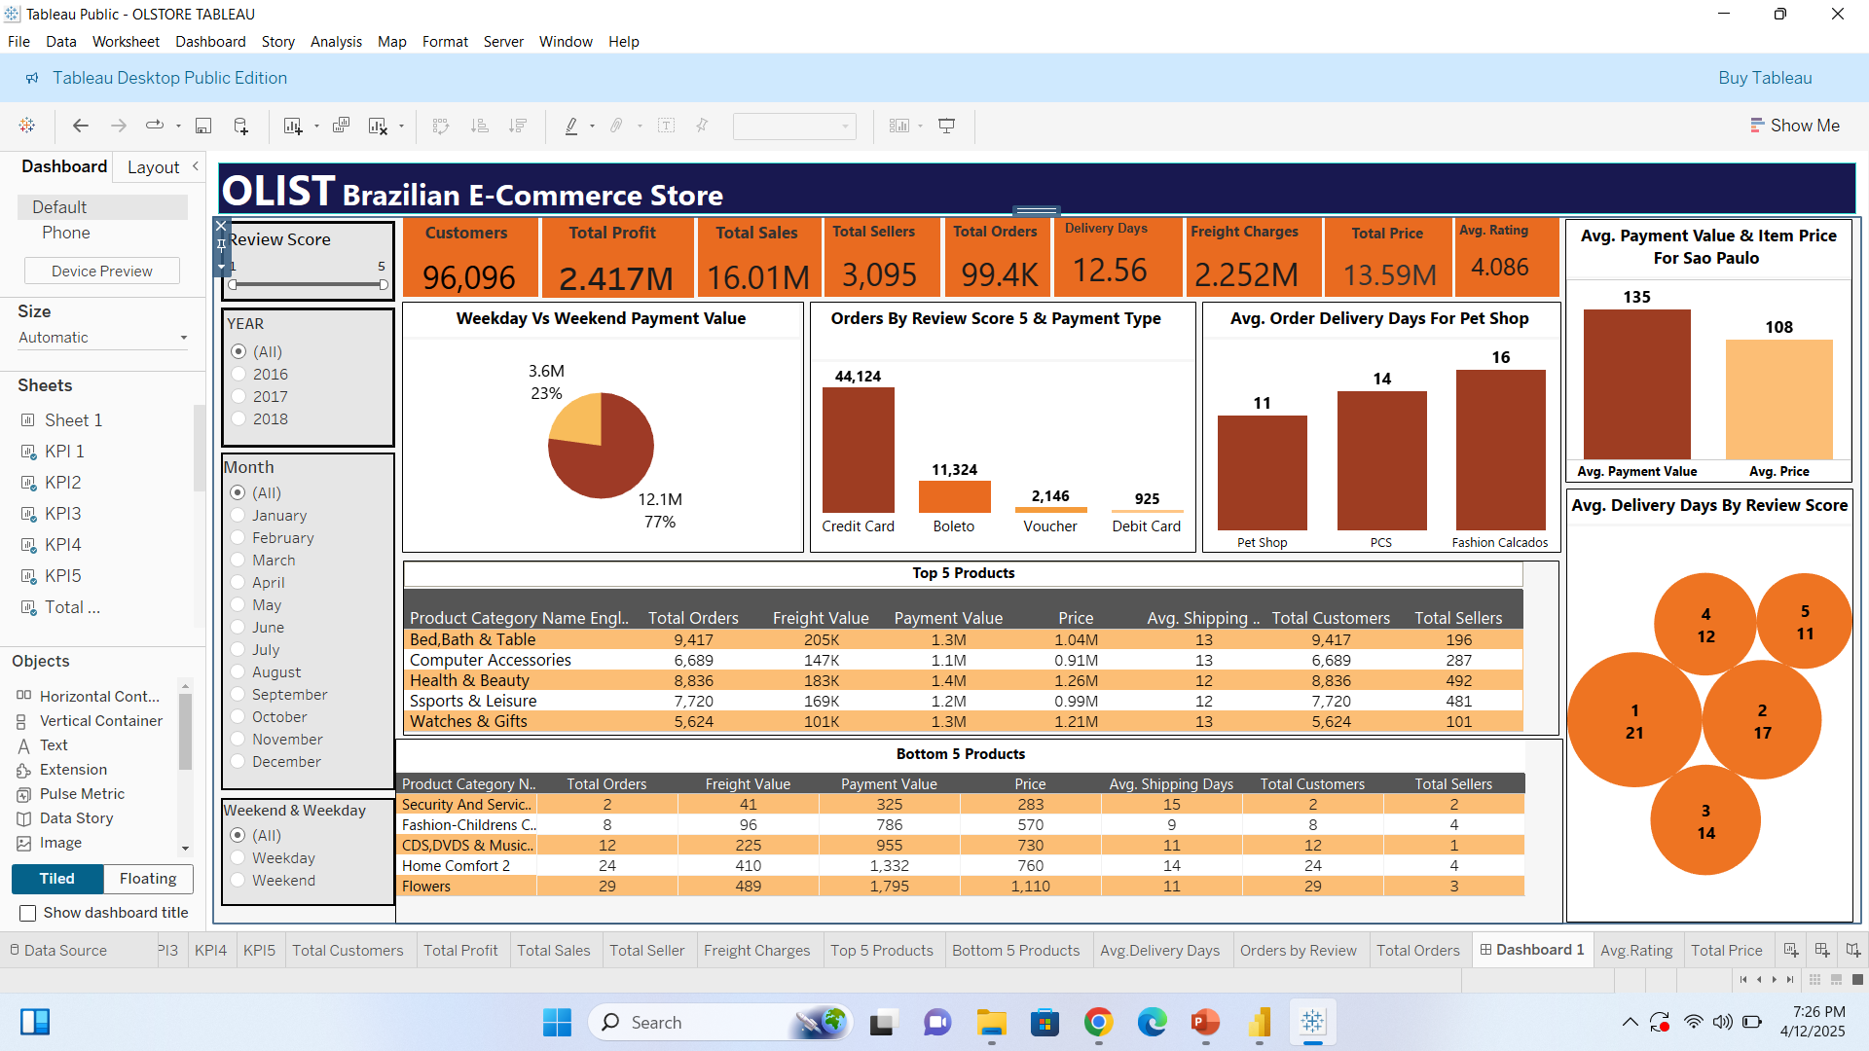

Slide 19
THANK YOU

